Slide 1
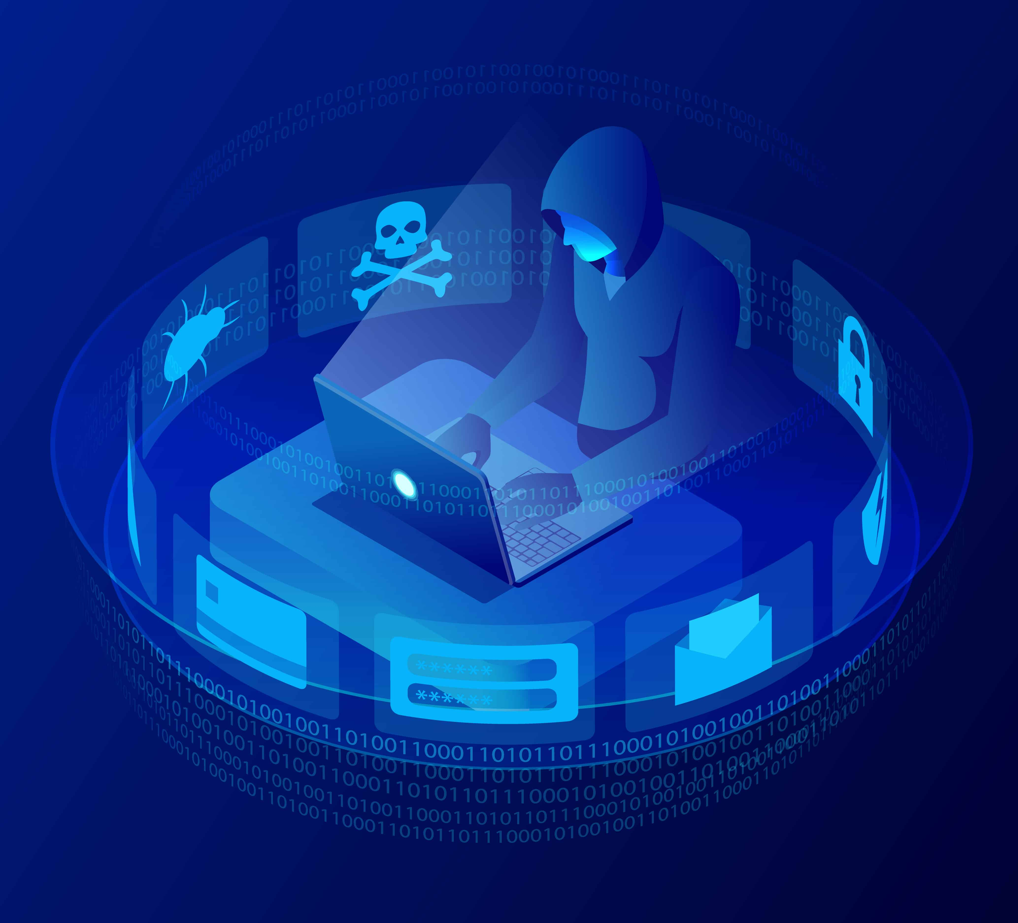
New England Hospital Security
An assessment of the New England Hospital overviewing:
- Security issues
- Vulnerabilities
Mitigation strategies
(Talk about what it is, 1st of its kind, opened Maidstone Kent, 4 may 2022 services for covid and provides 300 beds for rehabilitation)

Slide 2
Hospital IT Infrastructure
(Services operating on)
Workstations using Windows 8 or 10
Servers working on Windows 2016, 2019
Legacy Windows XP systems
Online Web Services via Internet to access records
(Patient Information held on)
Linux based SQL servers
J2EE Java Glass Fish application servers
(Login system built through Java Resource Adapter Architecture)
Active directories, web servers, SQL databases

Slide 3
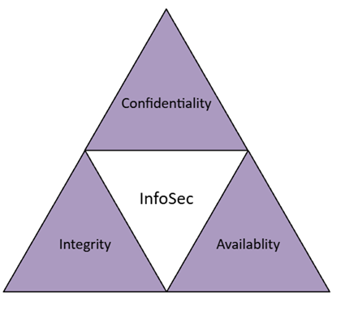
Why Security is Needed?
Information security (InfoSec) is the protection of both physical and digital information against unauthorised access, disclosure and disruption/alteration. (IBM, 2024, What Is Information Security? | IBM)
Why is infoSec important?
Prime target for attacks due to
value and importance (NHS Synnovis Ransomware Attack, up to 300 million records including patient data were stolen, June2024)
Keep data secure (and protected
against internal or external damage)
Reduce Risk of security breaches
Mitigate and remediate damage in
case of breaches
Maintain the principles of CIA
(Foundational to InfoSec, what it means?
preventing unathorised access
Preventing tampering to ensure authenticity and
reliability, data available when needed by authorised personnel in org)

Slide 4
Industry Standards
(2 primary recognised standards which help validate a companies proficiency in the InfoSec field)
ISO/IEC 27001
- Provides guidance for improving ISMS (Information Security Management System)
- Provides a centralised framework
- 5 steps of implementation
NIST SP 800/30
- Alternative to ISO/IEC 27001
- Provides a Risk assessment guideline
-6 Steps to conducting a risk assessment
In this case, NIST SP 800/30 has been used primarily
Report has worked primarily on cyber risk and threat
Management without the certifation standard that ISO requires
Define Scope and Objectives
Conduct Risk Assessment
Implement Security Controls
Monitor and Review Performance
Continuous Reiteration and Improvement
Identify Threat Sources
Identify Threat Events
Identify Vulnerabilities
Determine Likelihood of Threat Event
Determine the Negative Impact of Threat Sources
Determine Risks via the calculation (Likelihood x Impact)

Slide 5
Risk Assessment
The

Slide 6
Risk Matrix
Windows Server 2016, 2019 and Windows 8 are old systems (End of Life) No support due to lack of updating to protect against new vulnerabilities, replace as soon as possible
Threat of Spoofing

Slide 7
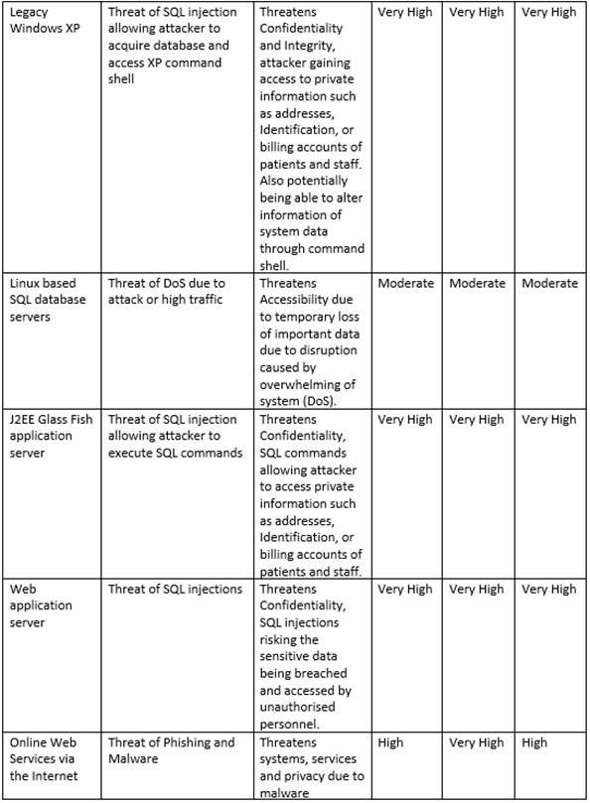
Risk Matrix
Legacy Windows XP is an End-of-Life system (no more support, however legacy systems are normally critical systems and essential to fulfil organisation needs)
SQL injections and DoS attack threat
Phishing threat

Slide 8
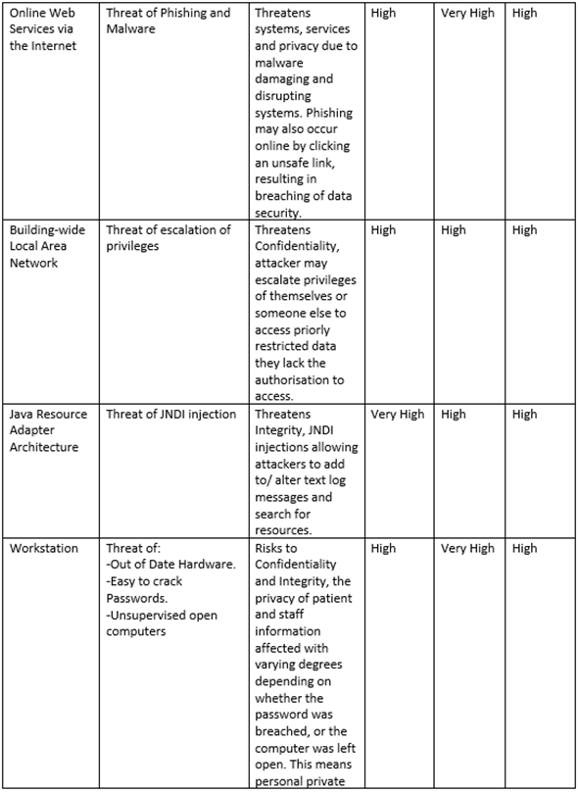
Risk Matrix
Threat of escalation of privileges and JNDI Injection
Outdated softwares.

Slide 9
Risk Matrix
Weak log-ins and their systems
Verbal sharing of potentially sensitive data
Physical access vulnerability

Slide 10
Identified Issues
End of Life
Lack of Firewalls
Lack of 2FA
Insufficient Security and Access Control
Lack of Antivirus
Lack of Encryption
Lack of Network Segmentation
These issues are easily solveable via the implementation of the lacking systems and the updating and improvement of current systems

